Slide 1
WEEKLY WORK SHOWCASE - CYBER SECURITY
Week 8 - Advanced VAPT
Chaining 5 Vulnerabilities into Full Application Compromise
🛒
Target - OWASP Juice Shop
⚒
Tooling - Burp Suite + Firefox
◯
Method - Manual Logic-Driven Testing
the payload that started everything
' or 1=1--
Local Isolated Lab - No Real Users, No Real Data

Slide 2
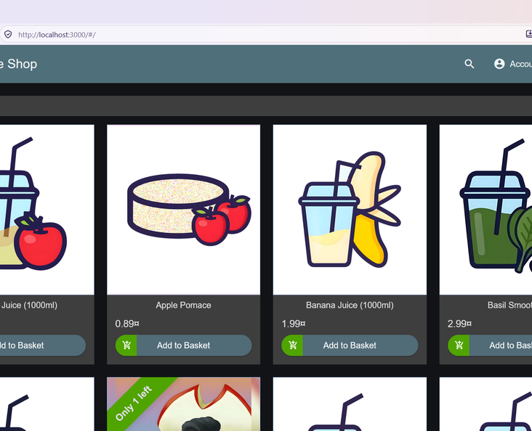
THE SETUP
Engagement at a Glance
localhost:3000
🛒
Target - OWASP Juice Shop running locally via Docker at localhost:3000, an intentionally vulnerable training app in a fully isolated environment.
⚒
Tooling - Burp Suite Community Edition (Proxy, Repeater, HTTP history) with Firefox routed through the Burp proxy.
◯
Method - Manual, logic-driven testing. No automated mass scanning - every step was hand-crafted.
Authentication
Admin Routes
Users + Basket APIs
Checkout Logic
Session Tokens
OWASP Juice Shop home page - the main entry point
5
vulnerabilities
1
3
-
chained exploit
-
severity levels

Slide 3
THE PLAN OF ATTACK
One Chain, Five Steps
Each step alone looks like a small finding - chained together they end in full compromise.
1
⚿
2
⛨
3
↗
4
⚙
5
◔
SQL Injection
Broken Access Control
IDOR
Parameter Tampering
Weak Session
Login bypass straight to the admin account, no password needed.
Other customers baskets read by changing one number in the URL.
Negative quantities accepted by the server without validation.
The token still works after the user logs out.
Hidden admin panel rendered fully, no server-side role check.
Anonymous visitor
Admin takeover
Data exposure
Order manipulation
Persistent access
→
→
→
→

Slide 4
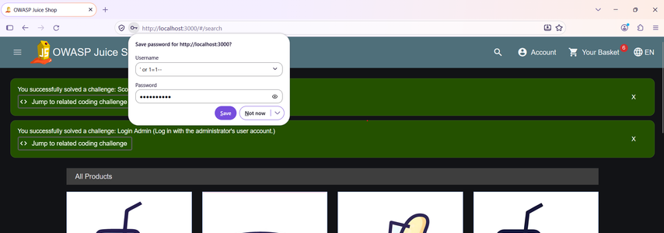
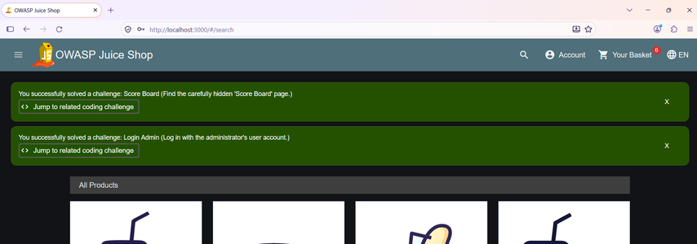
STEP 1 OF 5
Authentication Bypass via SQL Injection
✦
payload entered in the login email field
' or 1=1--
password: ********
The payload was submitted with an arbitrary password. It manipulates the underlying SQL query so the condition always evaluates true - the query returns the first user in the database, which is the administrator account. The login succeeded without ever knowing the real password.
The payload in the login field
✓
The application confirmed the exploitation itself - Login Admin and Score Board challenges solved.
⚡
Impact - an anonymous visitor becomes the administrator. This session powers every step that follows.
Challenges solved - proof of bypass

Slide 5
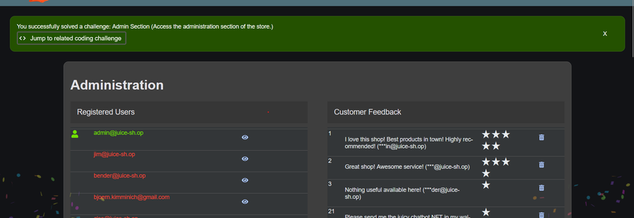
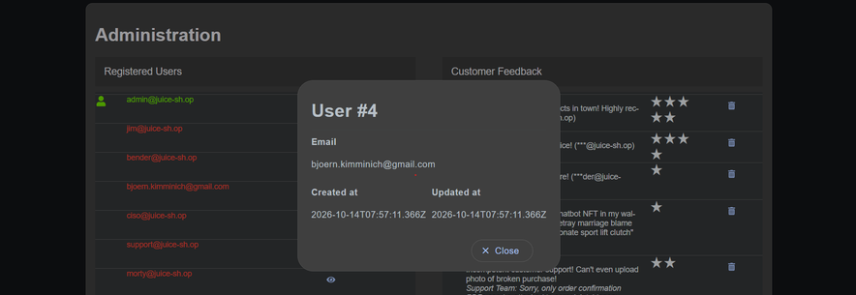
02
STEP 2 OF 5
Broken Access Control - Hidden Admin Panel
HIDDEN ROUTE, OPENED DIRECTLY
/#/administration
With the bypassed admin session active, the hidden administration route was opened straight from the browser address bar. It is not linked anywhere in normal navigation - yet the application rendered it fully, with no additional server-side role check.
Administration panel - every user and all feedback exposed
♟
Every registered user account listed with personal details.
◉
All customer feedback readable - and deletable - from the panel.
⚡
Impact - a hidden menu item is not access control. Authorization must be enforced on the server.
A user record opened - email and dates exposed

Slide 6
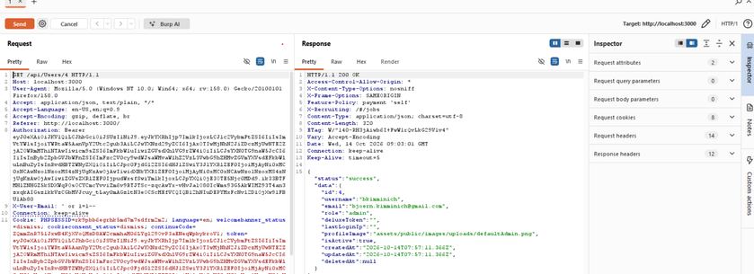
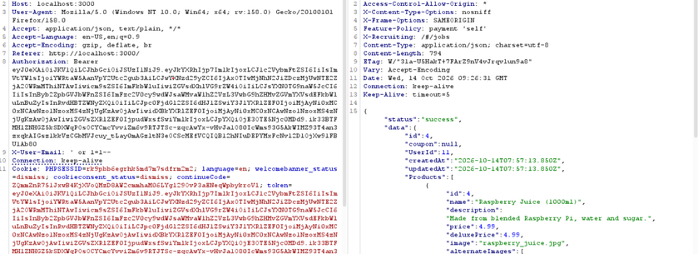
03
STEP 3 OF 5
IDOR - Reading Other Customers Data
OBJECT IDS EDITED DIRECTLY IN THE URL
GET /api/Users/4
GET /api/Basket/4
Numeric object IDs in the API URLs were edited while keeping the same session. The Users API returned a full user record for any ID. The Basket API was worse - baskets 1, 2, 3 and 4 each mapped to a different UserId.
Four customers, four baskets, one number changed
Users API - full record returned in Repeater
Basket 4
- UserId 11
Basket 3
- UserId 3
Basket 2
- UserId 2
Basket 1
- UserId 1
⚡
Impact - no ownership check on any object ID. Enumerating every user and basket takes seconds.
Basket 4 - belongs to UserId 11

Slide 7
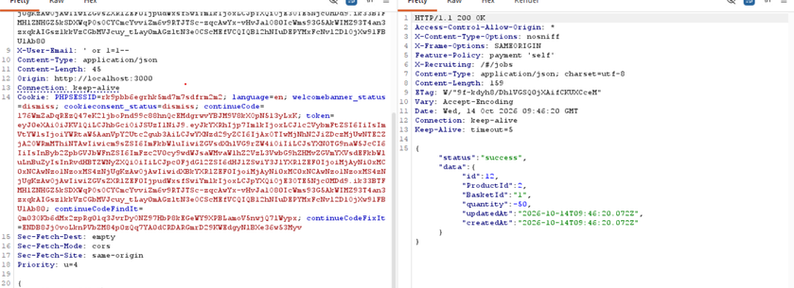
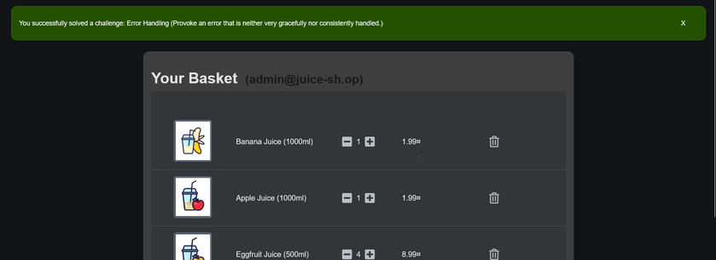
04
STEP 4 OF 5
Parameter Tampering on Basket Quantity
INTERCEPTED AND REPLAYED IN BURP REPEATER
POST /api/BasketItems/
{ "quantity": -50 }
The add-to-basket request was intercepted in Burp and replayed with a controlled body. A huge quantity was accepted with no upper limit - and a negative quantity of -50 was accepted too. No server-side validation exists at all.
Quantity set to -50 - success response
-50
-44
negative quantity accepted by the server
items shown on the basket icon after tampering
⊗
The app even awarded its own Error Handling challenge - this input was never expected.
⚡
Impact - client-supplied quantity is fully trusted. In production this can distort basket totals and billing.
Basket counter at -44 in the UI

Slide 8
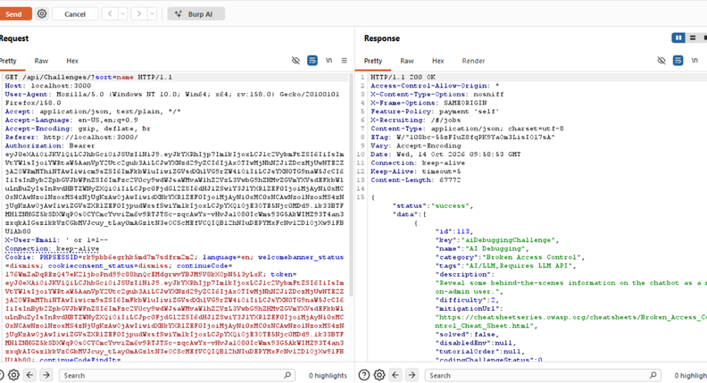
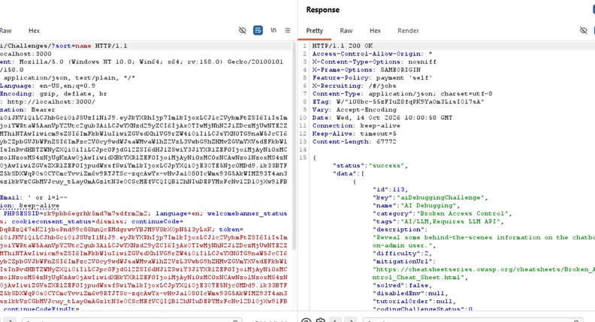
05
STEP 5 OF 5
Authorization: Bearer <same token>
The Token That Survived Logout
identical request, identical token - before and after
✓
BEFORE LOGOUT
⚠
AFTER LOGOUT
→
Request replayed with the Bearer token - success, full data returned.
Same request replayed unchanged after logging out - still success, still full data.
The account was logged out normally through the UI - the identical request was then replayed in Burp Repeater without changing a single character. The token was never invalidated server-side; logout only cleared the browser local state.
⚡
Impact - logging out is not containment. A captured token keeps working anywhere, anytime.

Slide 9
CONSOLIDATED VIEW
Risk and Impact Summary
Five findings, rated on the standard Low - Medium - High - Critical scale by exploitability and potential damage.
Vulnerability
Business Impact
Severity
1
Authentication Bypass
Attacker logs in as any user, including the admin, without knowing a password.
CRITICAL
(SQL Injection in login)
2
Broken Access Control
A full administrative interface is reachable with no server-side role check.
HIGH
(Admin Panel)
3
IDOR
Every customer personal data and order contents readable by changing one ID.
HIGH
(Users + Basket APIs)
4
Parameter Tampering
Arbitrary and negative quantities break pricing logic and basket totals.
HIGH
(Basket Quantity)
5
Weak Session
A captured token keeps working after the legitimate user logs out.
MEDIUM
(Token After Logout)
✿
The Critical rating exists because the bypass needs no prior access - everything else cascades from it.

Slide 10
REMEDIATION
Breaking the Chain
Each weakness needs its own fix - a single patch cannot close every step at once.
01
02
Use parameterized queries or an ORM with bound parameters - never concatenate user input into SQL.
Enforce server-side role checks on every administrative route - a missing menu item is not access control.
SQL Injection
Admin Panel
03
04
IDOR
Verify on the server that the logged-in user owns the requested object ID - on every request.
Quantity
Validate quantity server-side with a minimum of 1 and a sensible maximum - never trust client values.
Session Token
Keep a server-side token blacklist or short-lived tokens with refresh, so logout truly invalidates the session.
05
⌘
The weakest link - fixing the SQL injection first removes the entry point the entire chain depends on. Keep defense in depth anyway: never rely on a single control.

Slide 11
KEY TAKEAWAYS
What This Week Taught Me
Small bugs chain into big breaches
Hiding is not protecting
⌘
⊘
A hidden route or a missing menu link replaces nothing - server-side authorization is the real control.
Individually minor flaws combined into a full compromise of data and orders.
▤
✦
⌕
Never trust the client
Logout must mean logout
Manual testing finds what scanners miss
Every quantity, price and object ID must be validated on the server, every time.
Sessions need real server-side invalidation, not just a cleared browser.
Logic-driven exploration uncovered every link in this chain.
Breaking the chain starts with fixing the first link.

